Slide 1

Introduction to Python
January 22, 2019
Mike Babb, PhC
Department of Geography, UW

Slide 2
Why python?
It’s easy to jump in!
https://www.python.org/about/gettingstarted/
It’s cross-platform: Windows, Mac, Linux
It was designed to be simple and readable
https://xkcd.com/353/
It’s free!
https://www.python.org/
It’s prolific: used in many industries for many jobs. Finance, real estate tech, server administration, health care research, non-profit administration
And departments across campus: sociology, economics, civil engineering, astronomy
Many libraries that do pretty much what you want with just a few commands

Slide 3
Brief history
Developed by Guido van Rossum in the early 90s: current versions: Python 3.7.2 and Python 2.7.15
Python 3.7 is van Rossum’s (and the larger community’s) attempt at fixing some core issues with python 2.x
Integer division returns floats
Better handling of strings
Better memory management in some cases
It’s a bit faster in general: https://hackernoon.com/which-is-the-fastest-version-of-python-2ae7c61a6b2b

Slide 4
Anaconda and the Jupyter Notebook
https://www.anaconda.com/ - The python data science platform
Facilitates interactive python
Good for sharing and instruction
Easy to break code into manageable chunks

Slide 5
Starting the notebook server
Click start and search for and then select “Anaconda Prompt”
After approximately 30 seconds, type the following commands and then press enter once the commands have been entered.
U:
mkdir intro_to_python
cd intro_to_python
Jupyter notebook
After a few moments, you should see…

Slide 6
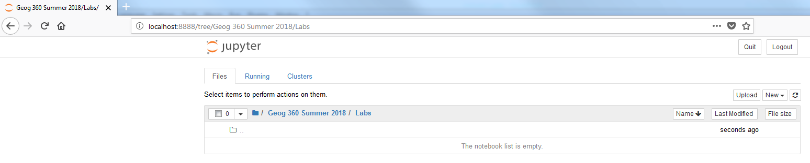
Jupyter Notebook

Slide 7
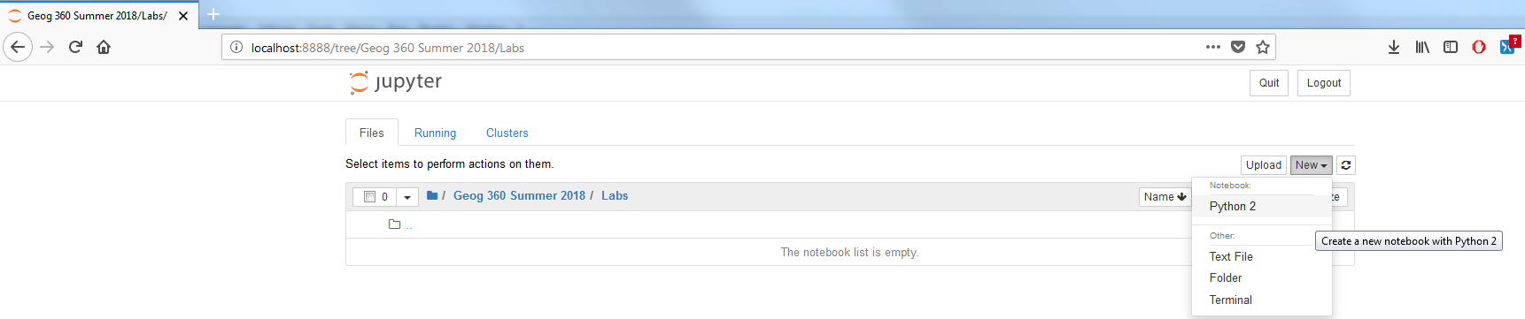
Creating a notebook

Slide 8
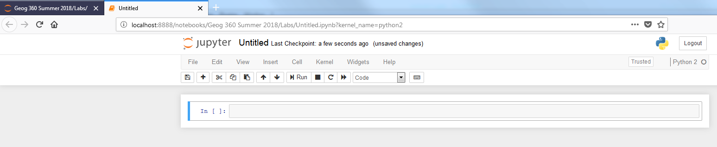
The Notebook…

Slide 9
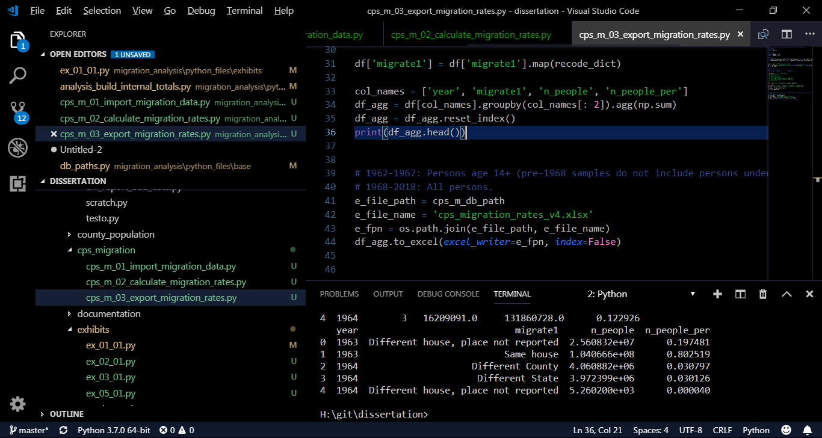
Python in… Visual studio Code

Slide 10
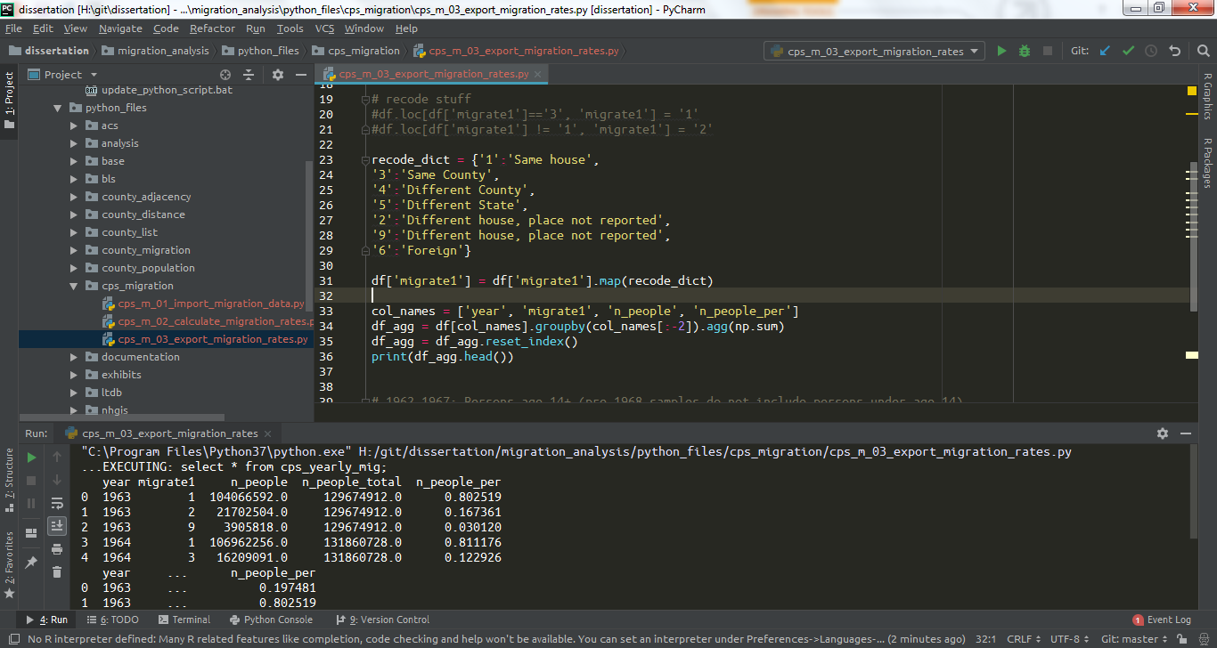
Python in… PyCharm

Slide 11
Finally… Python or R?
Both!!
Right tool for the job

